Slide 1

What is Business Intelligence?

Slide 2
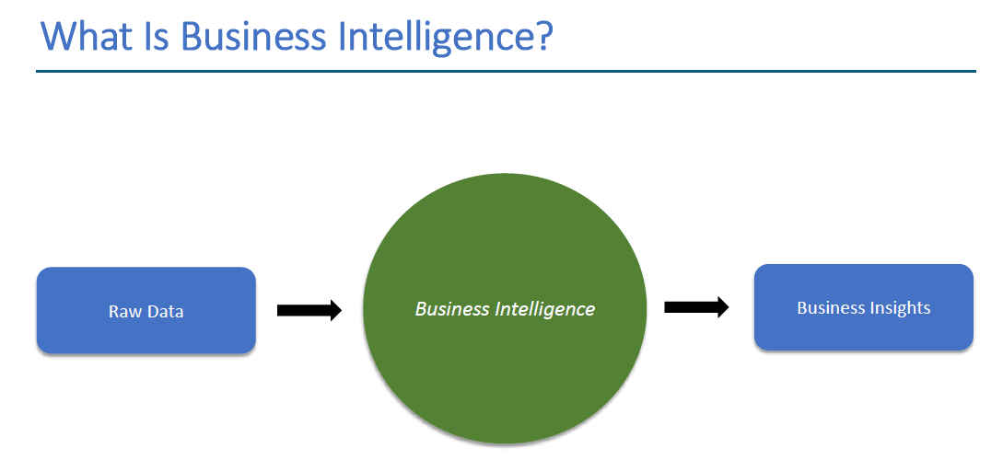

Slide 3
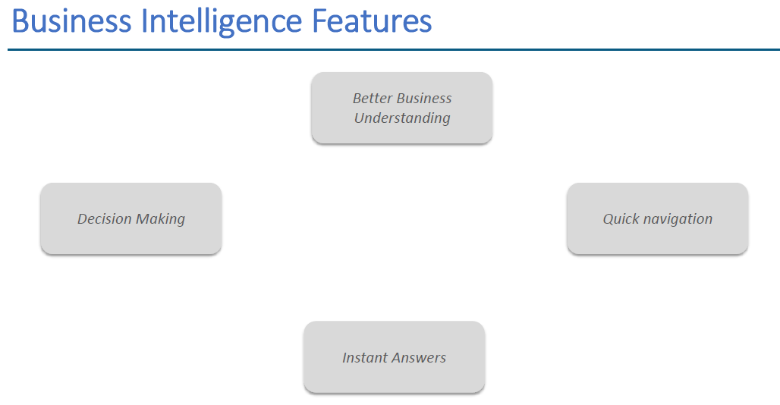

Slide 4

What is Data Visualization?

Slide 5
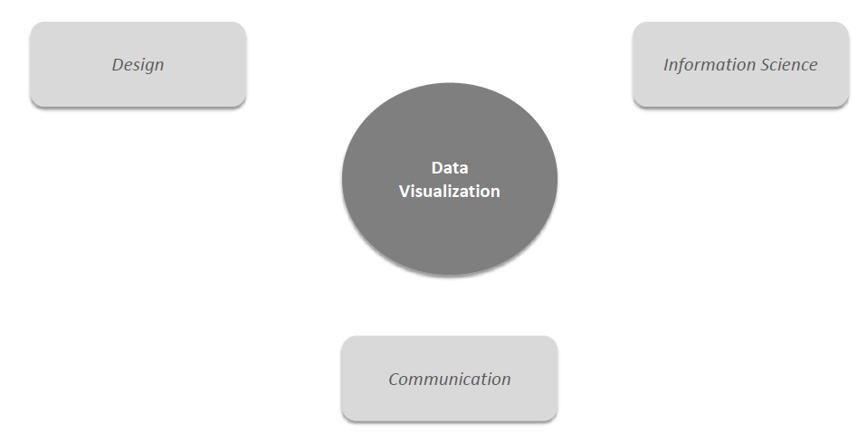
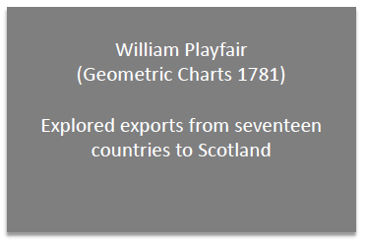
What is Data Visualization?

Slide 6
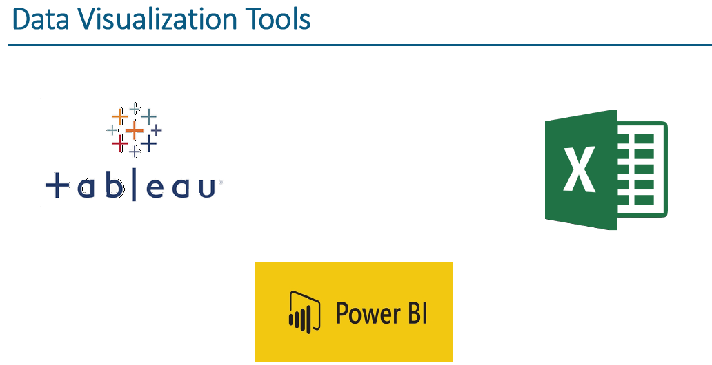
Data Visualization Tools
There are numerous data visualization tools such as
Tableau
Excel
PowerBI
Matplot
QlikView
FusionCharts
HighCharts
Datawrapper
Ploty
D3.js

Slide 7
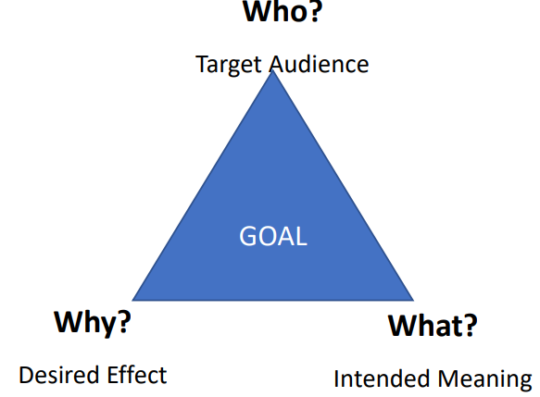
Six Principles of Communicating Data
Principle 1 – Know Your Goal
Principle 2 – Use the right data
Principle 3 – Select suitable visualizations
Principle 4 – Design for aesthetics
Principle 5 – Choose an effective medium and channel
Principle 6 – Check the result

Slide 8
Choosing the right Visuals

Slide 9
What Is Tableau?

Slide 10
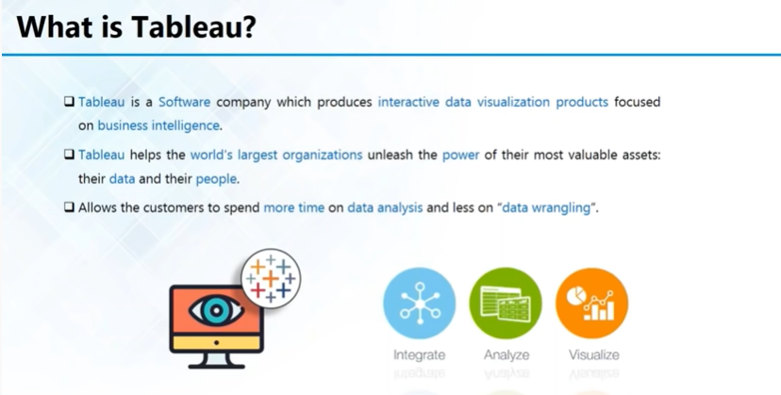

Slide 11
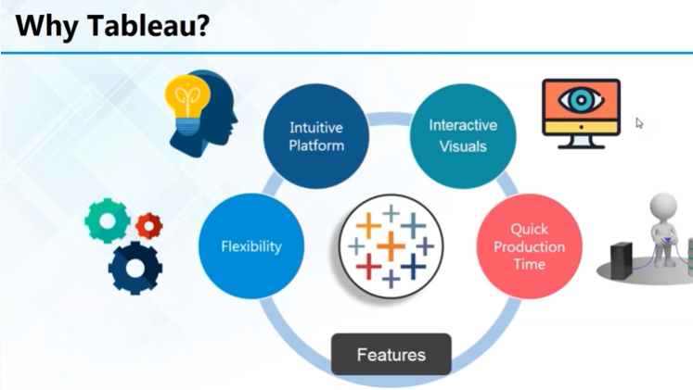

Slide 12
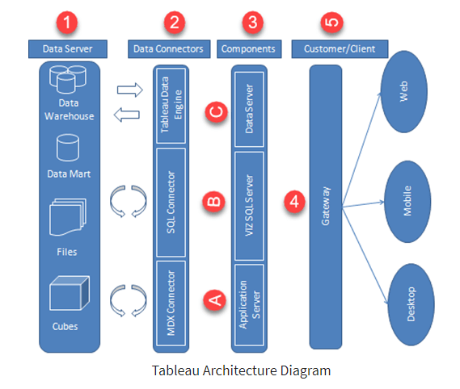
Tableau Architecture
Data Server
The primary component of Tableau Architecture is the Data sources it can connect to it.
Tableau can connect to multiple data sources. These data sources can be on-premise or remotely located.

Slide 13
Cont…
Data Connectors
The Data Connectors provide an interface to connect external data sources to Tableau Data Server.
Tableau has in-built ODBC/SQL connector. This ODBC Connector can connect to any databases without using their native connector. Tableau has an option to select both live and extract data. Based on the usage, one can be easily switched between extracted and live data.
Components of Tableau Server
The different components present in a Tableau server are:
Application Server
VizQL Server
Data Server
A) Application Server:
The application server is used to provide the authentications and authorizations. It handles the administration and permission for web and mobile interfaces. It assures security by recording each session id on Tableau Server. The administrator can configure the default timeout of the session in the server.

Slide 14
Cont…
B) VizQL Server:
VizQL server is used to convert the queries from the data source into visualizations. Once the client request is forwarded to VizQL process, it sends the query directly to data source and retrieves information in the form of images. This image or visualization is presented to the user. Tableau server creates a cache of visualization to reduce the load time. The cache can be shared across many users who have the permission to view the visualization.
C) Data Server:
Data server is used to manage and store the data from external data sources. It is a central data management system. It provides metadata management, data security, data storage, data connection and driver requirements. It stores the relevant details of data set such as metadata, calculated fields, sets, groups, and parameters. The data source could extract data as well make live connections to external data sources.

Slide 15
Cont…
Gateway
The gateway channelizes the requests from users to Tableau components. When the client makes a request, it is forwarded to external load balancer for processing. The gateway works as a distributor of processes to various components. In case of absence of external load balancer, gateway also works as a load balancer. For single server configuration, one primary server or gateway manages all the processes. For multiple server configurations, one physical system works as primary server while others are used as worker servers. Only one machine can be used as a primary server in Tableau Server environment.
Clients
The dashboards and visualizations in Tableau server can be viewed and edited using different clients. The Clients are Tableau Desktop, web browser and mobile applications.

Slide 16
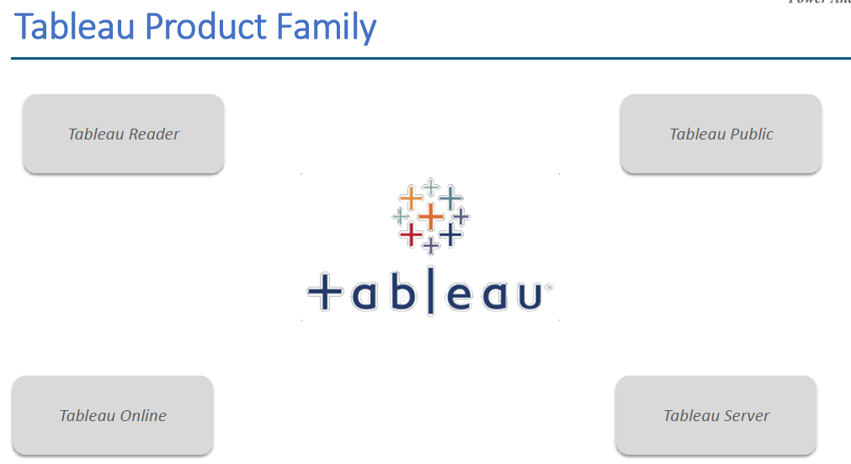

Slide 17
Tableau Desktop: Tableau Desktop allows the user to connect the data from different sources and build, dashboards, stories, and workbooks, With the Tableau Desktop and website, you can share all the insights with other users and publish the workbooks on the Tableau site. On Tableau Desktop, the user can run direct queries on the datasets without writing the codes.
Tableau Server: Tableau Server is used for publishing the reports and workbooks created on the Tableau Desktop. It enables the user to access workbooks and reports from anywhere in the world. With Tableau Server, you can access the latest content and gain live access to workbooks and reports generated by other users.
Tableau Online: Tableau Online is a cloud platform that makes it easy to publish and share the dashboards with other users. It helps you and your colleagues to work on a project and extract valuable information that can convert them into visually interactive workbooks.
Tableau Public: Tableau Public is a free application and visualization hosting service for sharing of publicly available data on the Web. You can create workbooks or reports and save them in the Tableau Server, but anyone can see those visualizations as its open for everyone.

Slide 18
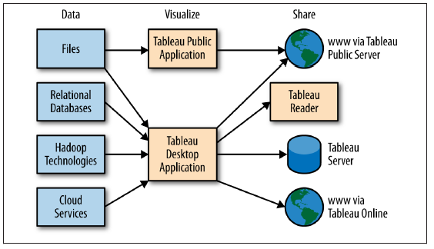

Slide 19
Why Tableau?
Visualization: Tableau connects with multiple data sources and supports larger datasets for accurate visualization. It uses a drill-down approach to reach that reveal the relationship between the independent variables. Also, the user can jump between different visualizations without any problem.
Performance: Tableau can connect with more data sources and handle huge datasets without affecting the performance of the data engine.
Depth of Discovery: Tableau has many ways to find out the solution to the questions asked by the user. From basic trends to advanced ‘what if’ queries, Tableau has the best features for data discovery and predictive analytics.
Automation Functionality: To save your time and efforts in Tableau, you can create processing and apply the same. Calculations on different visualizations.
Data Source Connectors: Tableau supports most data sources which make it easier to connect, clean, and identify hidden patterns in the raw data. It can access large datasets and from both On-premise and On-cloud sources without stressing out the system.

Slide 20
Application of Tableau
Quick visualizations and insights on disparate sources of data
You can leverage the power of your databases& optimize query performance
Work with statistical analysis like trending and forecasting features
Deploy extreme data discovery and unknown insights
Easily connect with computer programming languages for powerful table calculations
Work with data in the most intuitive, interactive manner through Tableau dashboards

Slide 21
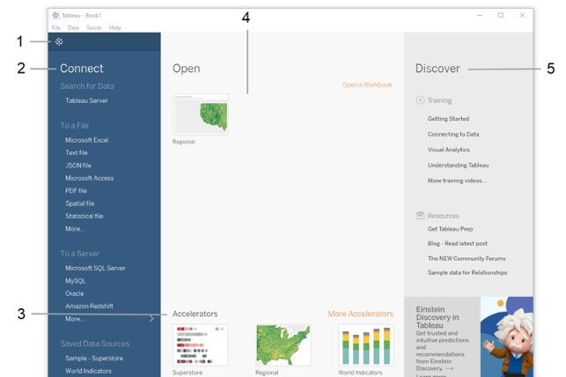

Slide 22
Tableau Page
1. Tableau icon: An icon of the Tableau logo in the upper left corner of any page to toggle between the start page and the authoring workspace.
2. Connect pane: Under Connect, you can:
Connect to data that is stored in a file, such as Microsoft Excel, PDF, Spatial files, and more.
Connect to data that is stored on Tableau Server, Microsoft SQL Server, Google Analytics, or another server.
Connect to a data source that you’ve connected to before.
Tableau supports the ability to connect to a wide variety of data stored in a wide variety of places. The Connect pane lists the most common places that you might want to connect.
3. Under Accelerators, view accelerator workbooks that come with Tableau Desktop. Prior to 2022.2, these were called sample workbooks.
4. Under Open, you can open workbooks that you've already created.
5. Under Discover you can find additional resources like video tutorials, forums, or the “Viz of the week” to get ideas about what you can build.

Slide 23
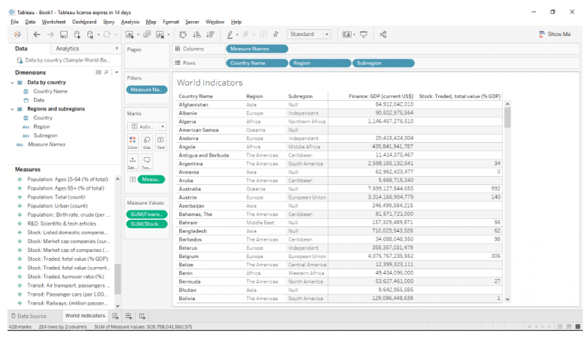
Tableau Workspace

Slide 24
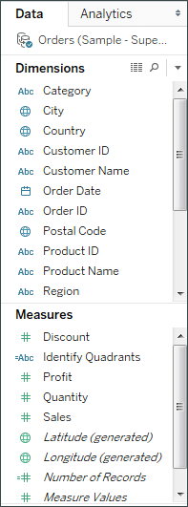
Data Window
Data field appears on the left side of the workspace in the data window.
You can hide and show the Data window by selecting
window -- > Show Data Window.
You can also click the minimize button in the upper right corner of the Data window.
Toolbar
Tableau’s Toolbar contains a command like connect to data, New sheet and Save.
It also contains analysis and navigation tools like Sort, Group and Highlight.

Slide 25

Status Bar
It is located on the bottom of the Tableau workbook.
It displays descriptions of menu items as well as information about the current view.

Slide 26
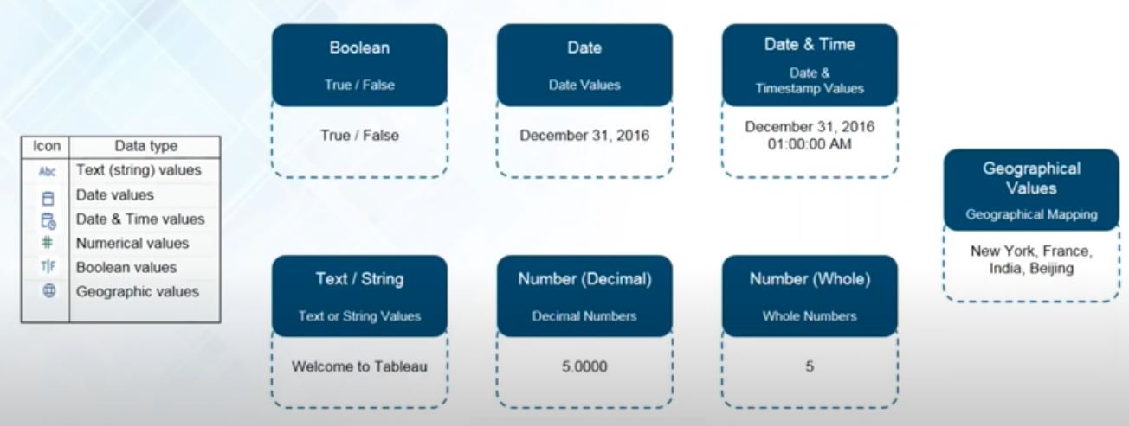
Tableau Data Types

Slide 27
Dimensions and Measures
When you connect to a new data source, Tableau assigns each field in the data source as dimension or measure in the Data pane, depending on the type of data the field contains.
Dimensions contain qualitative values (such as names, dates, or geographical data). You can use dimensions to categorize, segment, and reveal the details in your data. Dimensions affect the level of detail in the view.
Measures contain numeric, quantitative values that you can measure. Measures can be aggregated. When you drag a measure into the view, Tableau applies an aggregation to that measure (by default).

Slide 28
For Example

Slide 29
Tableau Desktop UI
Every Tableau workbook contains both sheets and dashboards.
Sheets are for creating individual visualizations, and
Dashboards are for combining sheets and other objects like images, text, and web pages on the same canvas, and adding interactions between them such as filtering and highlighting.

Slide 30
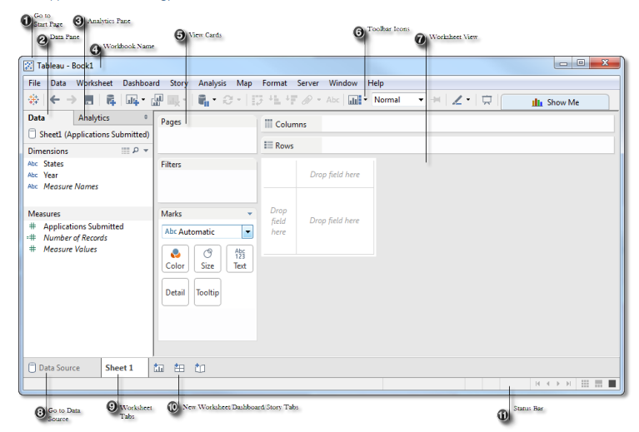

Slide 31
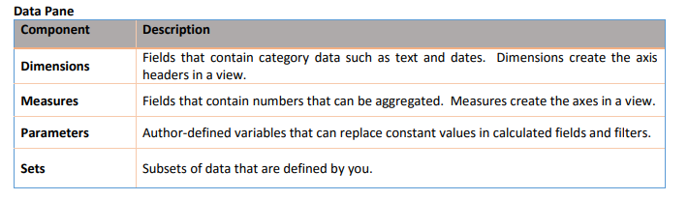
Tableau Workspace

Slide 32
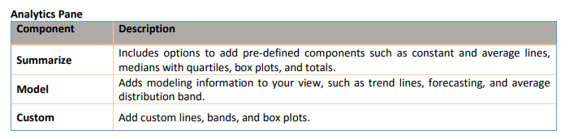
Tableau Workspace

Slide 33
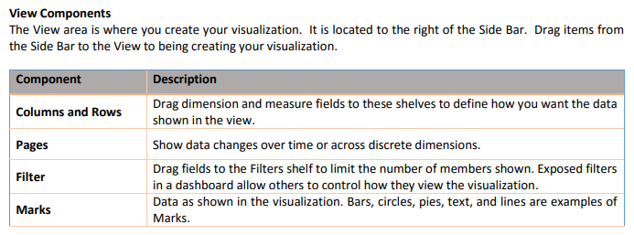
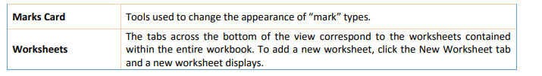
Tableau Workspace

Slide 34
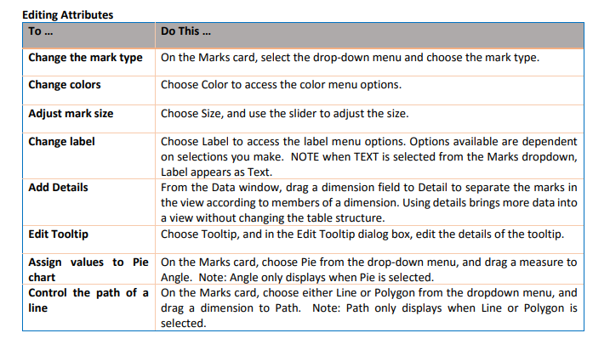
Tableau Workspace

Slide 35
